Slide 1
CS-E4740 Federated Learning “FL Project” Dipl.-Ing. Dr.techn. Alexander Jung

Slide 2
FL Project
pick any application you like and model it as a FL problem
you must:
define/choose local datasets (train/val/test sets)
define/choose local models
define/choose loss functions
define/choose edges and their weights
define/choose discrepancy measure

Slide 3

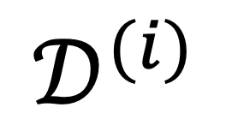
Local Datasets
$$𝒟^{(i)}$$
each local dataset
consists of a
train set: used to define local loss in GTVMin
val set: used to select local models and/or edges
test set: used for final performance assessment

Slide 4
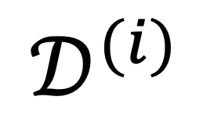
Local Models
local dataset
$$𝒟^{(i)}$$
local model can be anything listed in MyCourses Section “FL Project”
where did we choose loss function here?

Slide 5
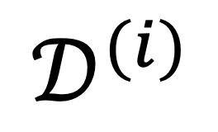
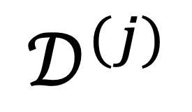
Choose Edges and Weights
$$𝒟^{(i)}$$
local dataset
$$𝒟^{(j)}$$
either choose manually (using your domain expertise) or a graph learning method (see Sec. 7.5 of lecture notes)

Slide 6
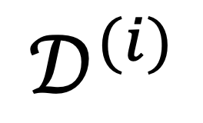
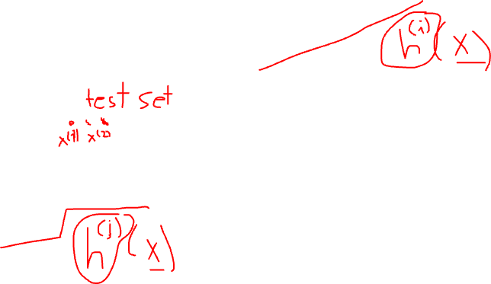
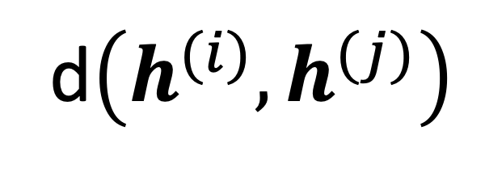
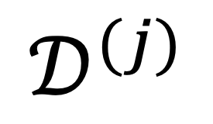
Discrepancy Measure (Variation)
$$𝒟^{(i)}$$
local dataset
compare local hypothesis at node i with local hypothesis at node j
via some discrepancy measure
$$𝒟^{(j)}$$
d$\left(h^{(i)},h^{(j)}\right)$

Slide 7
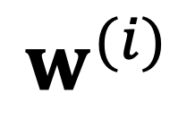
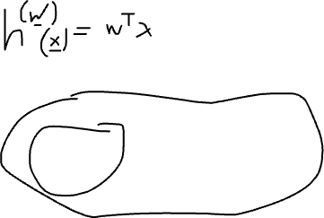
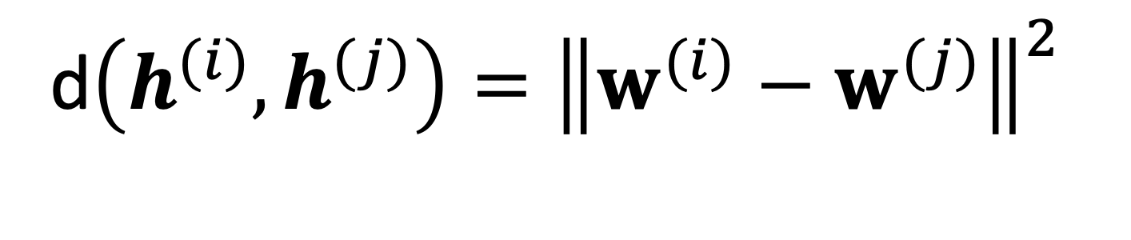
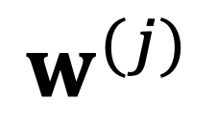
Variation of Parametric Models
node i
local model param. vec.
$$w^{(i)}$$
d$\left(h^{(i)},h^{(j)}\right)={\left\|w^{(i)}−w^{(j)}\right\|}^{2}$
node j
local model parameters
$$w^{(j)}$$

Slide 8
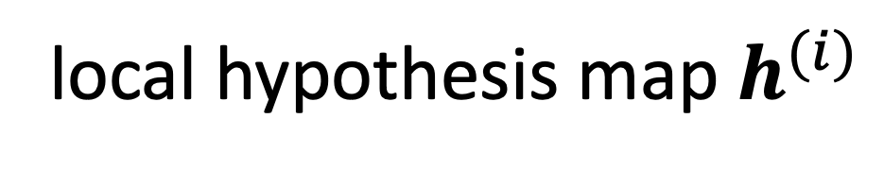
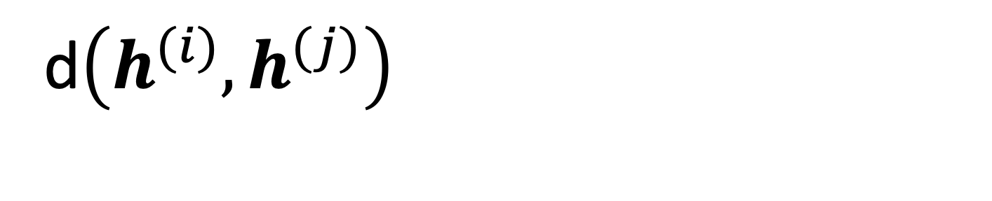

Variation of Non-Param. Models
node i
local hypothesis map $h^{(i)}$
d$\left(h^{(i)},h^{(j)}\right)$
node j
local hypoth. $h^{(j)}$

Slide 9
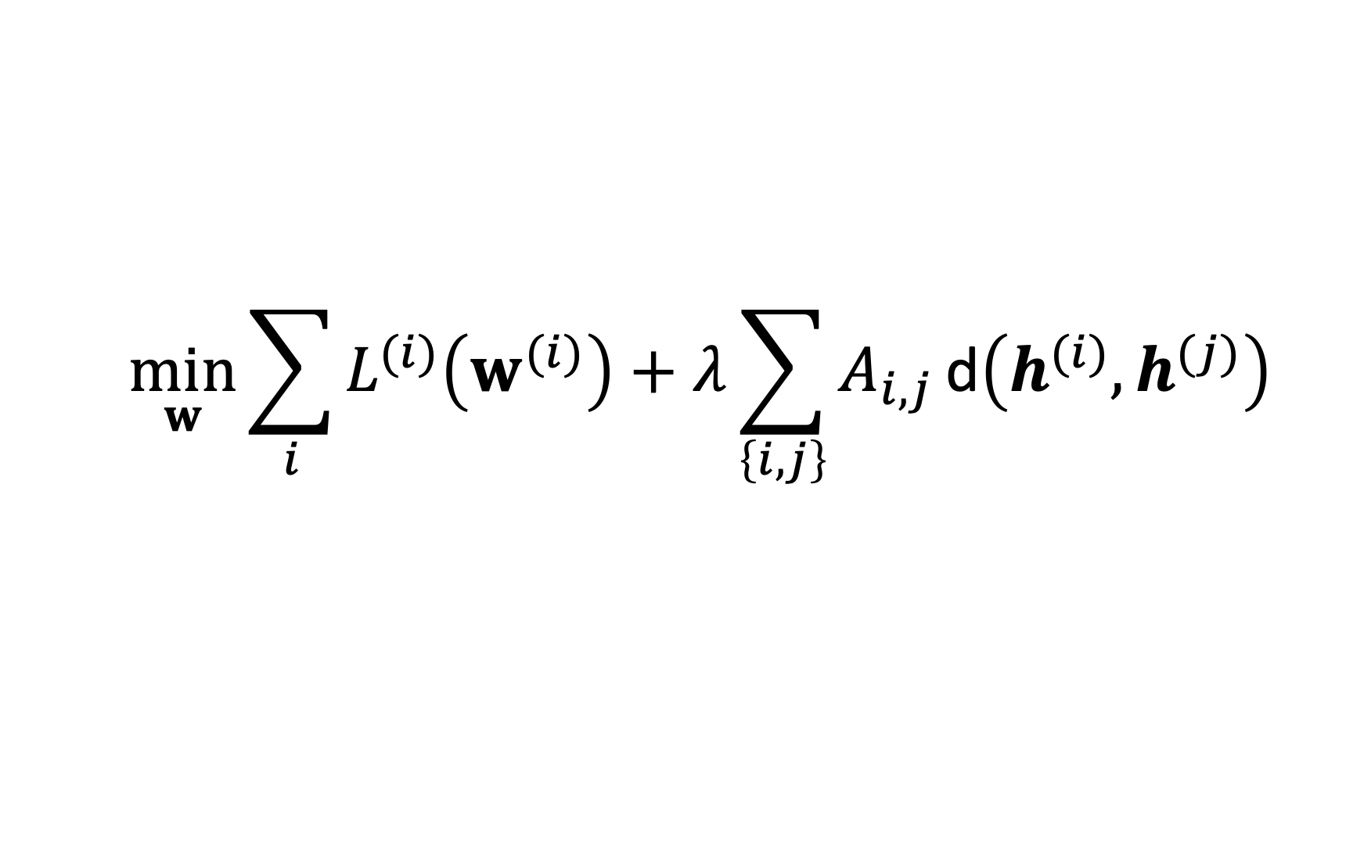
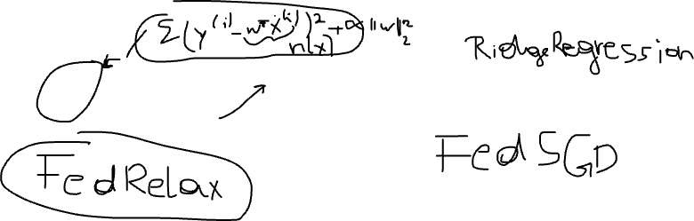
Putting Together the Pieces
$$\min_{w}{\sum_{i}{L^{(i)}\left(w^{(i)}\right)}+λ\sum_{\left\{i,j\right\}}{A_{i,j}}\text{d}\left(h^{(i)},h^{(j)}\right) }$$
FL Algos obtained by applying (very) well-known optimization methods to solve this GTVMin [1, Sec. 9]

Slide 10
FL Project Credits and Grades
extends course from 5 to 10 credits
project points P2 (max. 80 report/max 20 review)
basic variant points P1 (max 100)
grade for 10 credit variant determined from
½ ( P1 + P2)
1: 50-59; 2: 60-69; 3: 70-79; 4: 80-89; 5: 90-

Slide 11
FL Project Deliverables
project teams of max. three students
each student submits project report + notebook
peer grading during 15 – 31.05.2023
final submission = project report + python notebook
+ response to peer reviews

Slide 12

FL Project Schedule
now
prepare project report +
notebook with experiments
15.05.2023
peer review
31.05.2023
revise project report +
notebook with experiments
prepare response letter

Slide 13
Introduction
Problem Formulation
Methods
Results
Conclusion

Slide 14
Introduction
describe application domain
summarize existing work
outline of paper

Slide 15
2. Problem Formulation
provide qualitative description of local datasets:
what are datapoints? [2, Ch. 2]
what is the quantity of interest (label)? [2,Ch. 2]
what is the data source ?
intrinsic similarity betw. local datas.? [1, Sec. 6]

Slide 16
3. Methods
how data split into train/val/test set? [2, Ch. 6]
which local models/local loss and why those?
which discrepancy measure ? [1, Sec. 7.1, 7.4]
which FL algorithm used ? [1, Sec. 9]
how did you validate trained models? [2, Ch. 6]

Slide 17
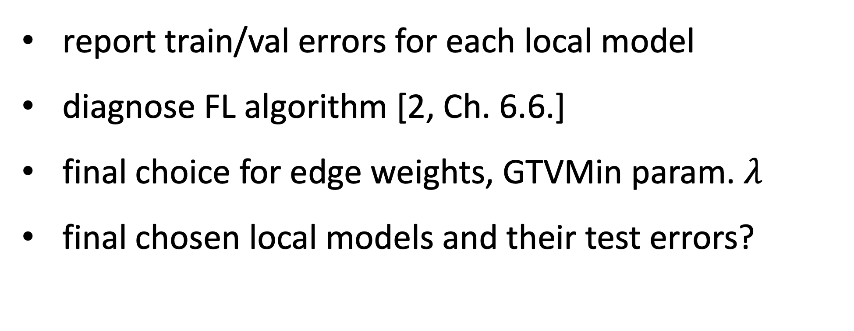
4. Results
report train/val errors for each local model
diagnose FL algorithm [2, Ch. 6.6.]
final choice for edge weights, GTVMin param. $λ$
final chosen local models and their test errors?

Slide 18
5. Conclusion
recap your findings during the project work
ponder about limitations and possible improvements

Slide 19
References
[1] AJ, “Lecture Notes CS-E4740”, 2023
[2] AJ, “Machine Learning: The Basics,”, Springer, 2023

Slide 20
Peer Review Questions
draft for you to comment: click here

Slide 21
revise report and notebook based on peer review

Slide 22
Final Submission:
revised report (pdf)
revised notebook with experiments (ipynb)
response letter that explains how you used the peer review (sample)

Slide 23
Thank you for
your attention!

